Slide 1
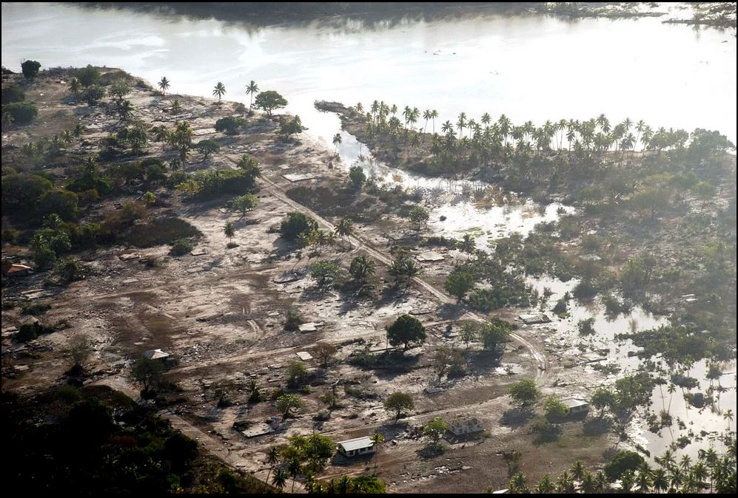
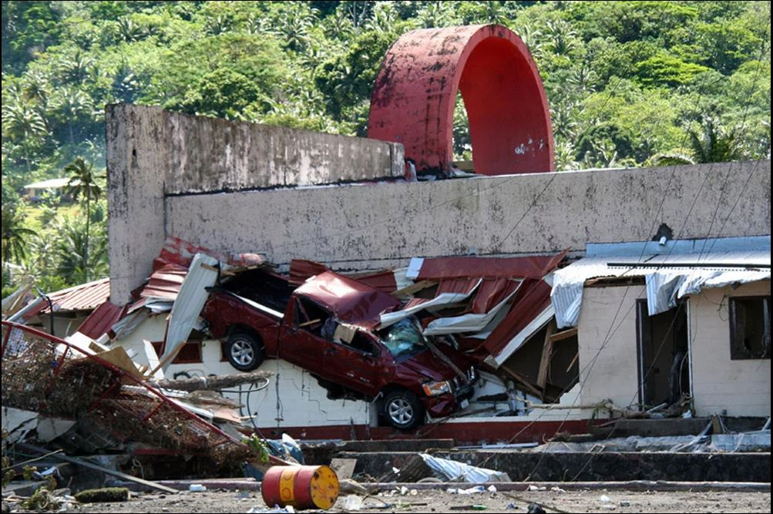
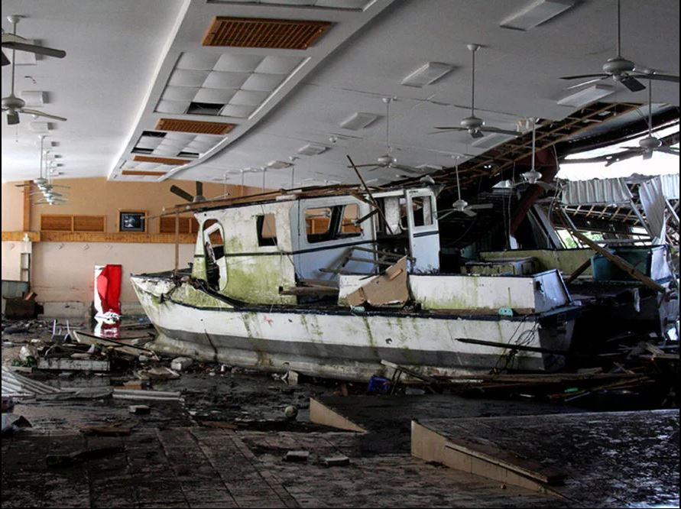
Real-Time Flood Forecasting System for American Samoa to Improve Preparedness, Public safety, and Risk Mitigation
Sayed M. Bateni¹, Casey TeBeest², and Chris Shuler²
¹Department of Civil, Environmental and Construction Engineering, and Water Resources Research Center, UHM
²Water Resources Research Center, UHM
September 2023

Slide 2
Understanding the Urgency: Why do we need a reliable real-time flood forecasting system?
Floods are the deadliest natural hazard affecting American Samoa, causing loss of life and significant economic damage.
Flood risks are increasing with more population density near streams and climate change.
No reliable flood forecasting system exists for American Samoa’s main streams, leaving the territory vulnerable to intense rainfalls.
Over $80 millions in damages have been documented over the last two decades due to floods.
In this project, the focus will be on the main streams of American Samoa, e.g. Fagaalu, Fagasa, Vaipito, Nuuuli, Leone, etc.
This project will use advanced machine learning techniques to forecast flood for 1 to 5 hours ahead (on the hourly time scale); and for 1 to 2 days ahead (on the daily time scale).

Slide 3
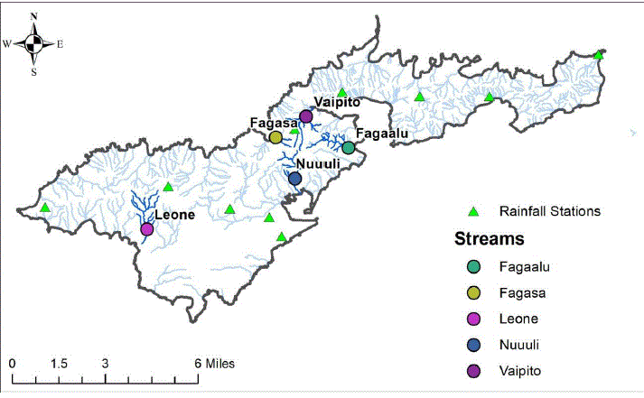
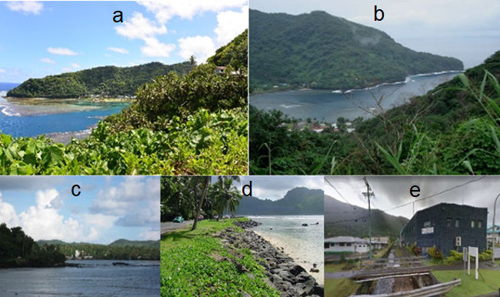
Study area, geography, and climate change
Geographical Constraints:
Only 34% of the land has a slope of less than 30%.
Residents live in narrow valleys are prone to flooding.
Climate & Weather Patterns:
Located within the South Pacific Convergence Zone.
Impacted by climate change, frequent storms, and cyclones.
Photos of (a) Fagaalu, (b) Fagasa, (c) Leone, (d) Nuuuli, and (e) Vaipito rivers in American Samoa.

Slide 4
Understanding the Geography & Climatic Factors Behind Flooding in American Samoa
Historical Impact:
At least $80 million in damages over the last two decades.
Multiple losses of life due to flooding and heavy rains.
Future Projections:
Increase in annual rainfall by up to 14% (Shuler et al., 2020).
Potential to increase surface runoff and flooding by up to 50% (Shuler et al., 2020).
Critical Infrastructure at Risk:
Transportation facilities, roads, and bridges in low-lying areas are vulnerable.
Terrain includes very steep slopes and floodplains.
Sea level rise threatens areas further inland.
Floods are the most common environmental hazard in American Samoa.

Slide 5
Goal: Developing a Reliable Real-Time Flood Forecasting System for American Samoa
01
01 - Data Collection
Acquire hourly rainfall and streamflow data from WRRC-ASPA weather stations/gages, and stations/gages we will install by the support of this project.
02
- Data Quality
03
Control the quality of measured data and fill gaps in them.
- Model Development
04
Use robust machine learning approaches to predict flood at various forecast horizons (i.e., 1-5 hours ahead and 1-2 days ahead).
05
- Performance Assessment
Use statistical metrics including root mean square error to evaluate the accuracy of the predictive models.
- Stakeholder Engagement
Coordinate an interagency effort (Office of Disaster Assistance and Petroleum Management, American Samoa Power Authority (ASPA), U.S. Army Corps of Engineers (USACE), and National Weather Service (NWS)) to evaluate and incorporate the real-time flood forecasts into the NWS flood warning system.

Slide 6
Data Analyses and Flood Forecasting Methodology
Data Sources
Gap-Filling
Hourly streamflow data will be collected from stream gauges.
Rainfall and air temperature data will be collected from weather stations.
Gaps in streamflow data of each river will be filled based on neighbouring rivers data using deep learning models.
Forecasting Techniques
Robust machine learning approaches will be applied to forecast 1-5 hours ahead and 1-2 days ahead streamflow for each river.
Deep learning models will be used because they can effectively handle time-series data to fill the gaps.
Machine learning models will be utilized for flood forecasting because of their robustness.

Slide 7
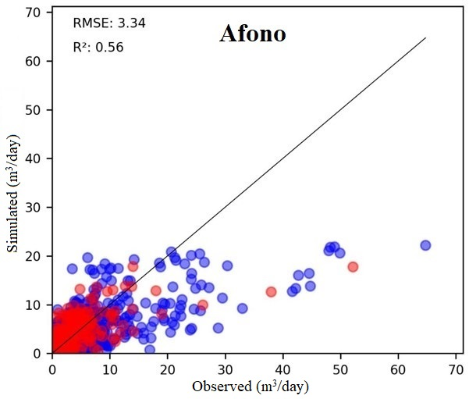
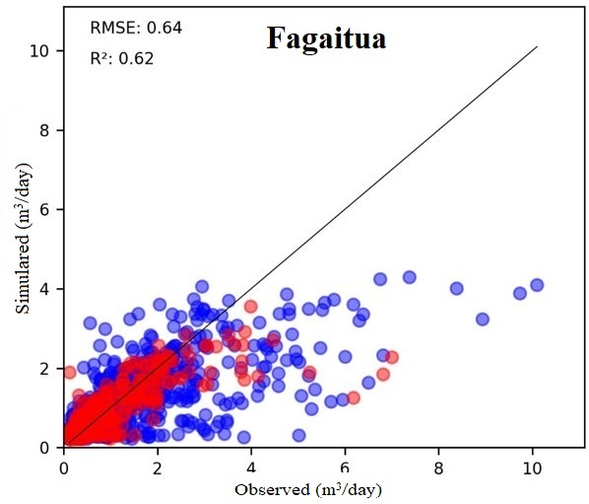
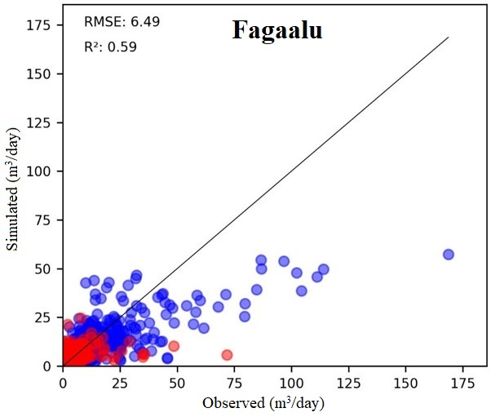
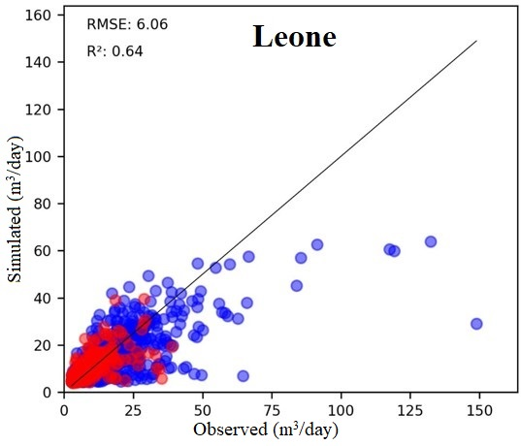
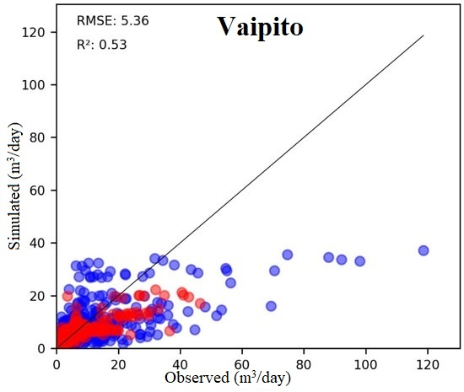
Results: 1-day ahead streamflow forecasts for five streams
Machine learning model was trained with data from 2016-2020 and tested from 2021-2022.

Slide 8
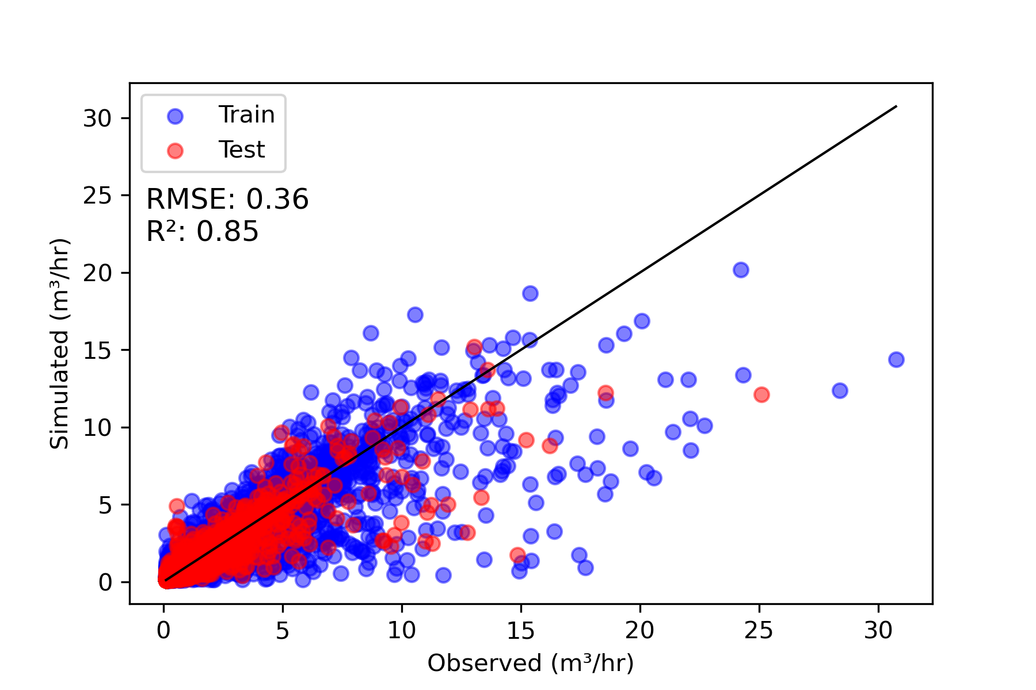
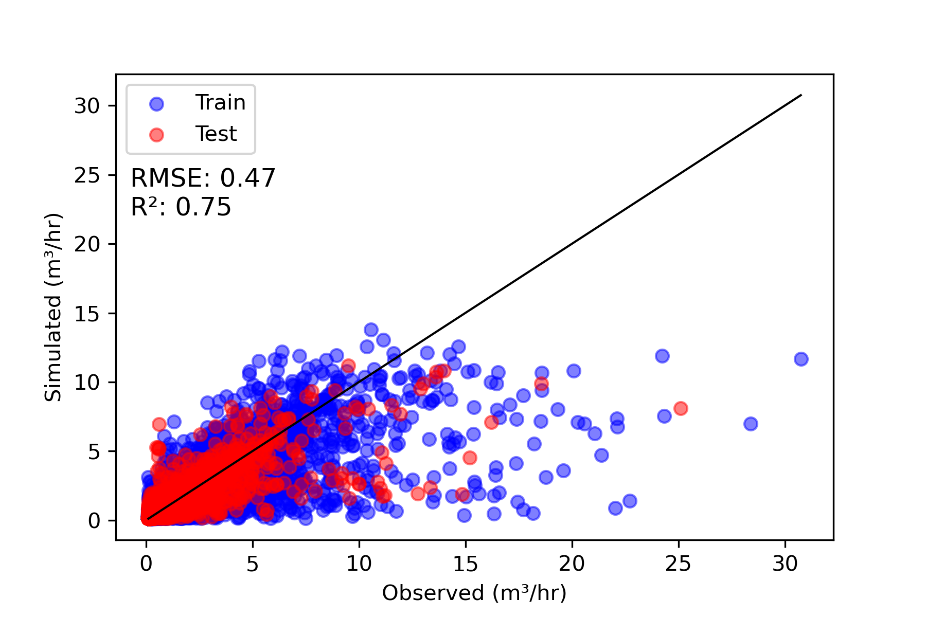
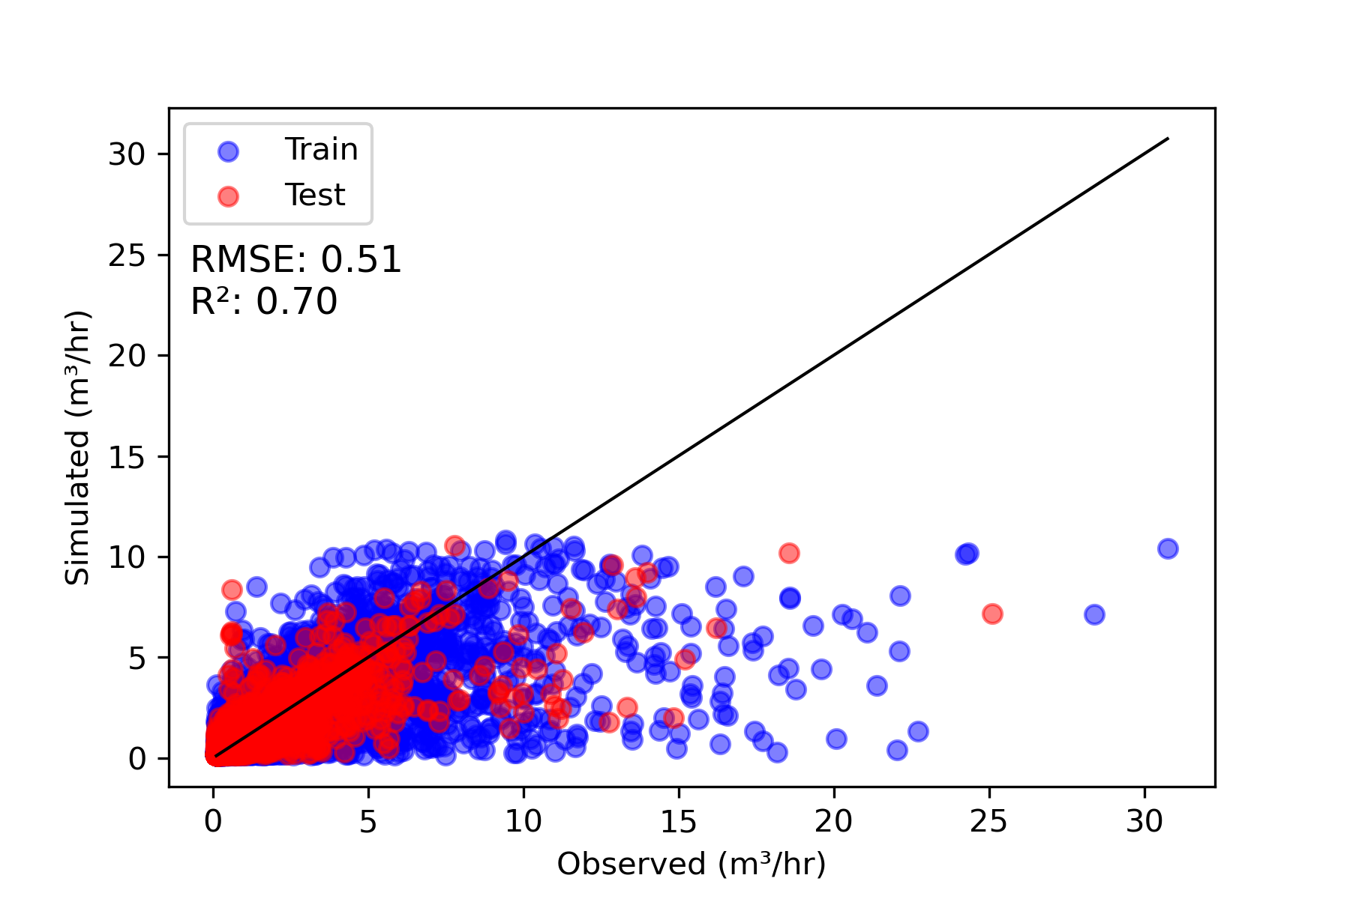
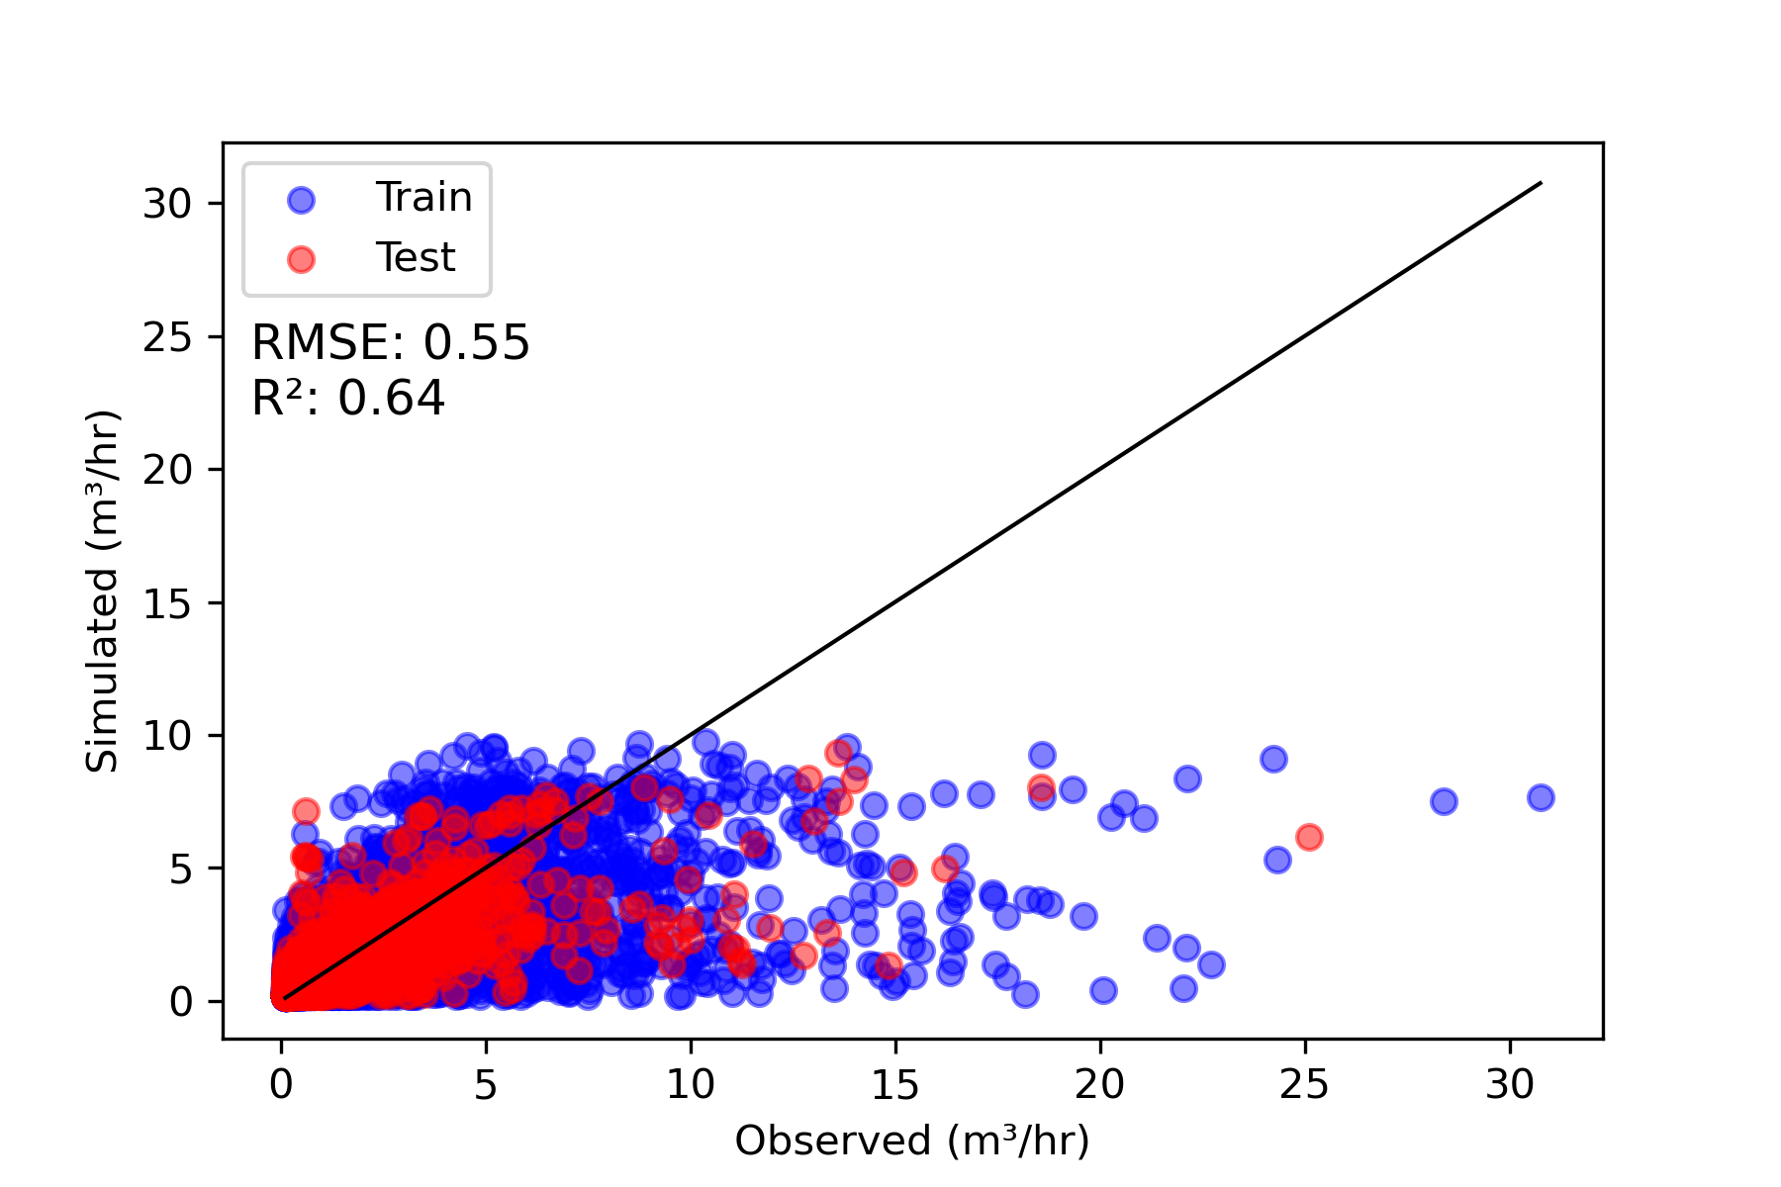
Results: 1- to 4-hours ahead streamflow forecasts for Fagaitua
Machine learning model was trained with data from 2016-2020 and tested from 2021-2022.
In this study, we used 5 years to train the model.
Results will be better in next years because we will have more training data.
In general, forecasts will be more accurate, the more we have data to train the model.
1-hr-ahead
2-hr-ahead
3-hr-ahead
4-hr-ahead

Slide 9
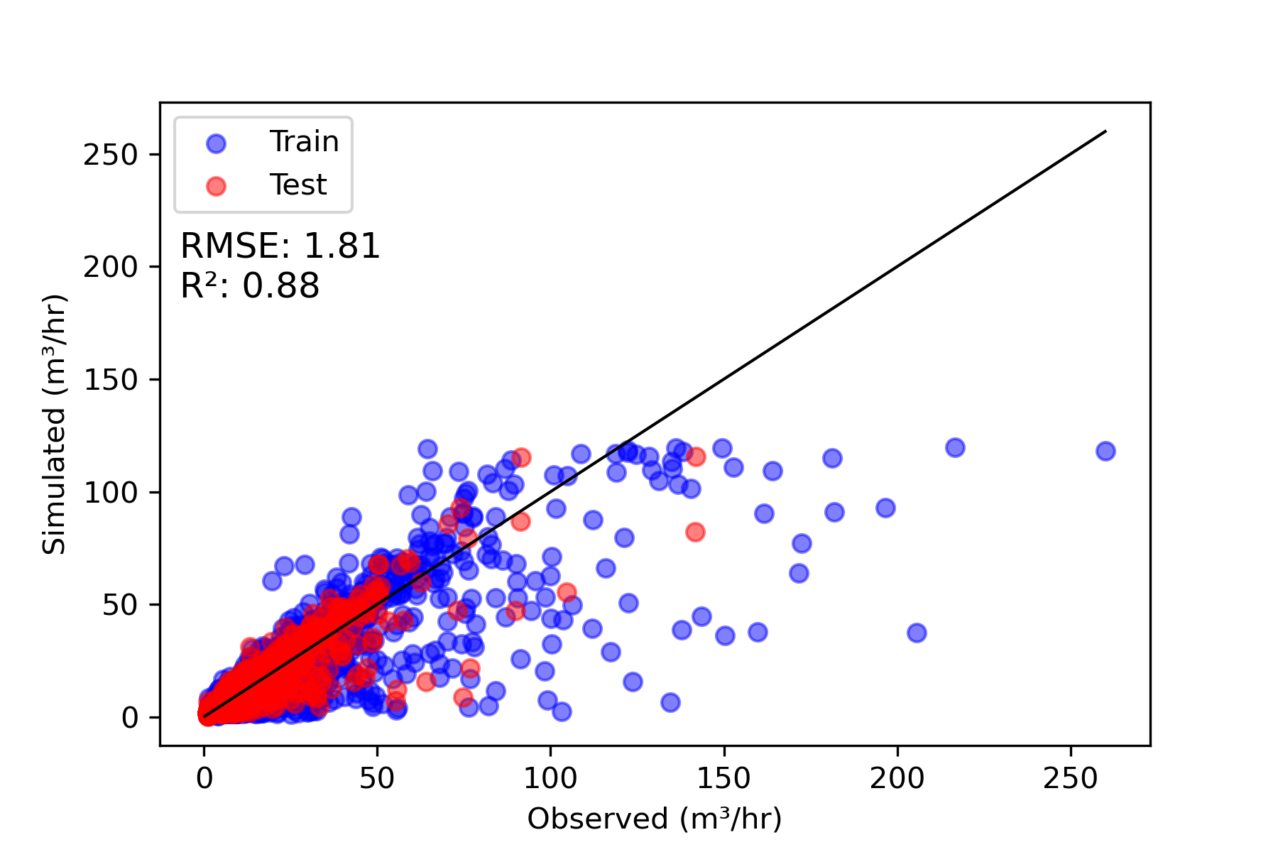
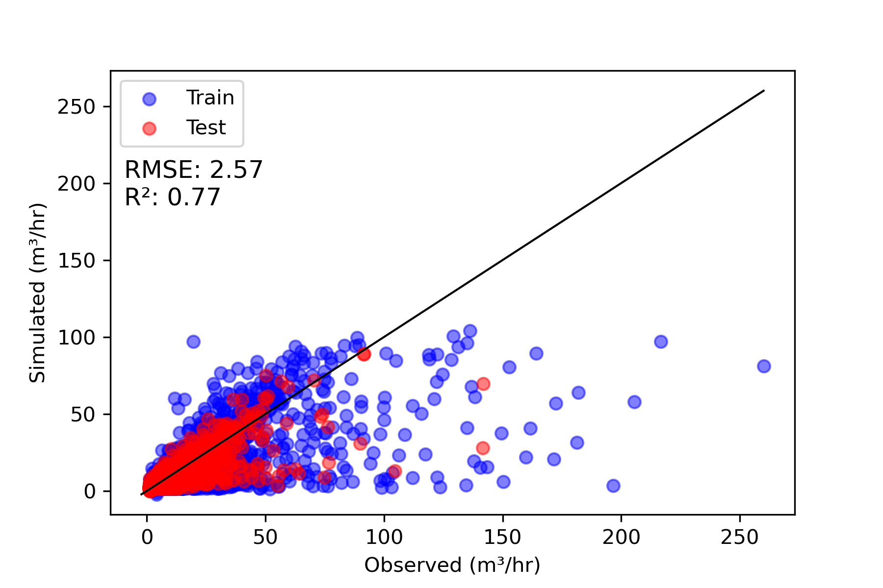
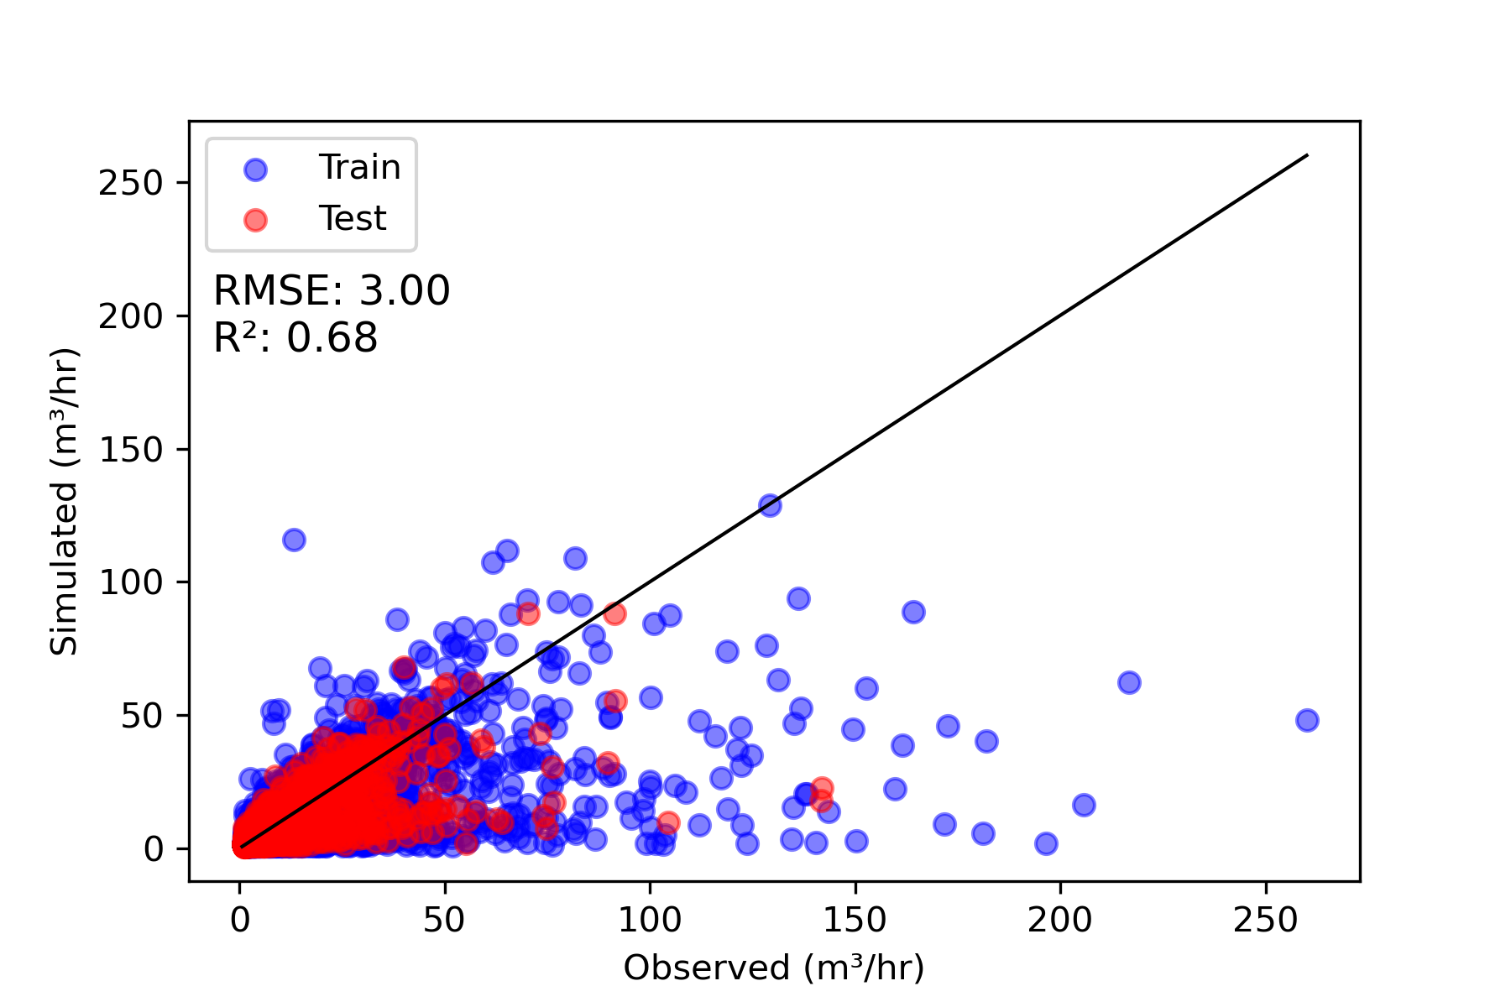
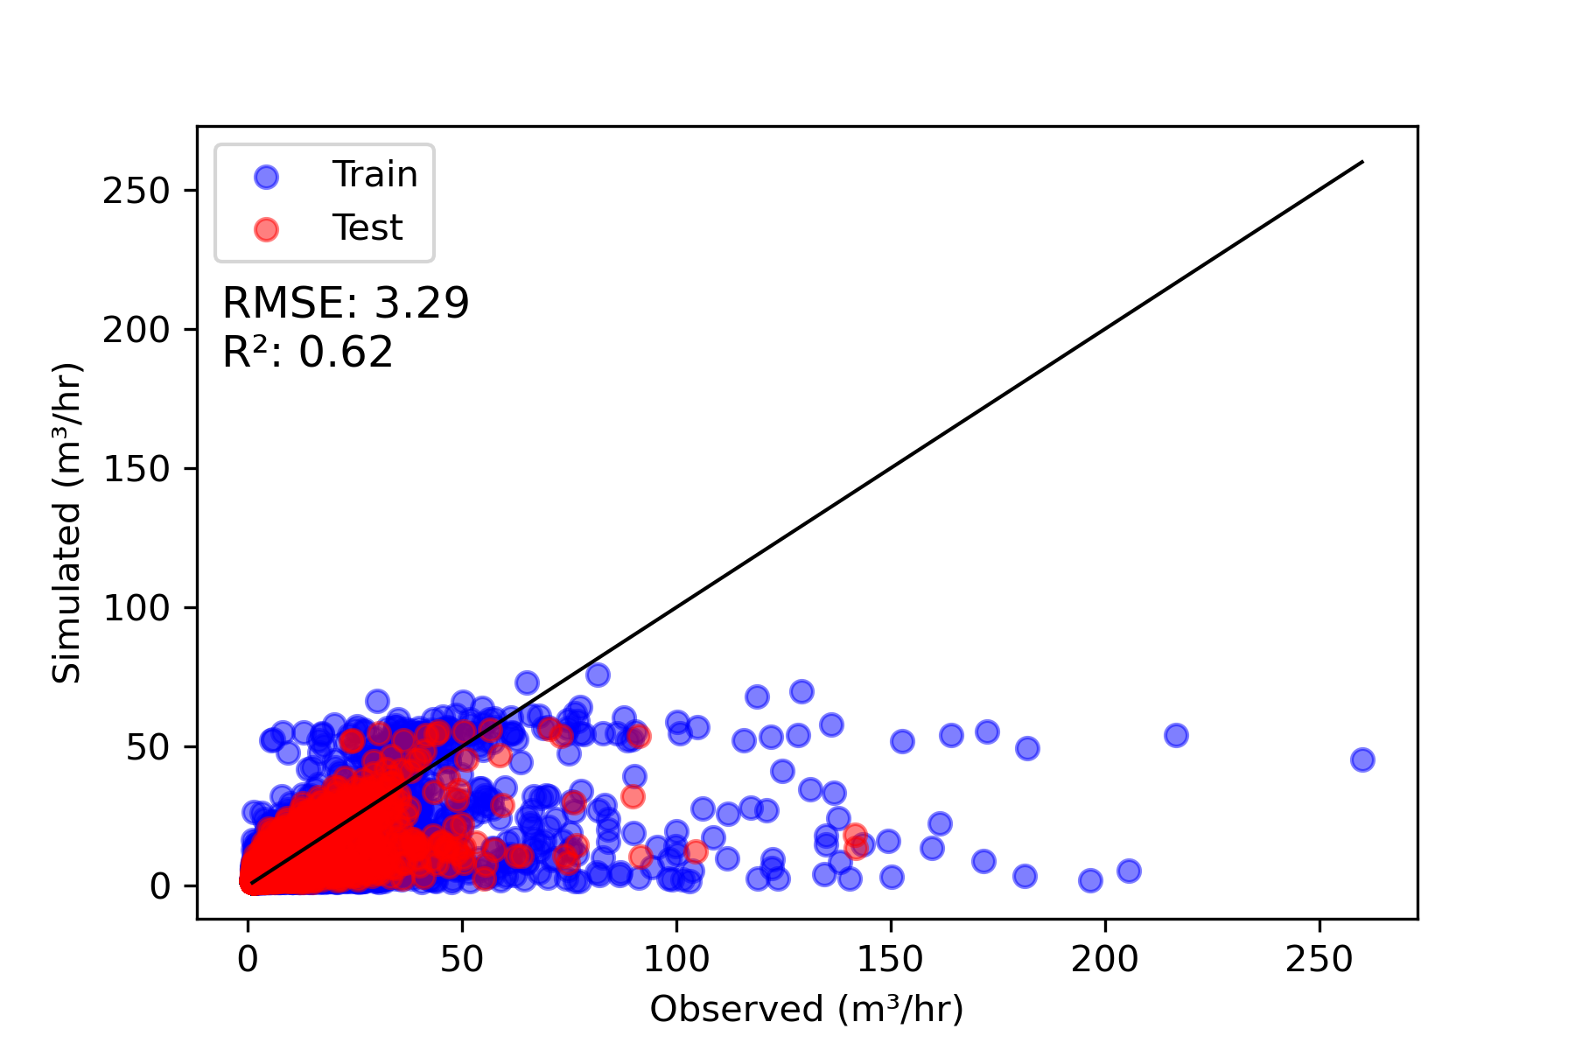
Results: 1- to 4-hours ahead streamflow forecasts for Fagasa
Machine learning model was trained with data from 2016-2020 and tested from 2021-2022.
In this study, we used 5 years to train the model.
For real-time flood forecast system, data from 2016-2023 (8 years) will be used to train the model, which will definitely improve the results.
1-hr-ahead
2-hr-ahead
3-hr-ahead
4-hr-ahead

Slide 10
References
Shuler, C.K., Brewington L., El‐Kadi, A. I. (2020). cshuler/Tutuila-SWB-Scenarios: Pre-print_release. https://doi.org/10.5281/zenodo.3958286. v1.0, Zenodo.

Slide 11
Thank you for your attention

