Slide 1
Department of Youth & Women’s Affairs (DYWA)
Our mission is to inspire growth for youth and women through instructive programs, skill training, seminars, cultural programs, and informational network programs. In addition, act as a liaison between resources, attain gender equality, promote health & wellness activities and ensure inclusion of persons with disabilities.
The vision of DYWA is to empower, uplift and improve the quality of life for the youth and women of American Samoa through nurturance, education, training, development information, networking and
services.

Slide 2
WHO WE ARE

Slide 3
WHAT IMPACT WE CAN MAKE
Including women in disaster planning creates resilience.
Elevating women’s voices can reduce fear and panic during a disaster. It is a risk reduction and resilience building, with game-changing potential for the community.

Slide 5
Women Coalition of American Samoa

Slide 6
The WCAS’s mission is to strengthen, empower, and unite (SEU) the women of American Samoa

Slide 7
Engaging with women responders
Access
Understanding
Reach
Voice
Solidarity
Gender transformative
-Women’s resilience to disasters knowledge Hub.

Slide 8
Building Security For Family
Challenges:
Inadequate housing conditions
Lack of financial resources
No emergency preparedness plans
No communication

Slide 9
Building Security For Family
Positive reinforcement
Empower women to make her house a home
Empower women to build a safe and resilient community

Slide 10
Building Security For Family
:
Helpful solutions:
Make an evacuation route plan
Identify your shelter plan or meeting locations
Create an emergency community plan
Prepare 72-hour kits

Slide 11
Partners Community Fair

Slide 12
Forming Partnerships

Slide 13
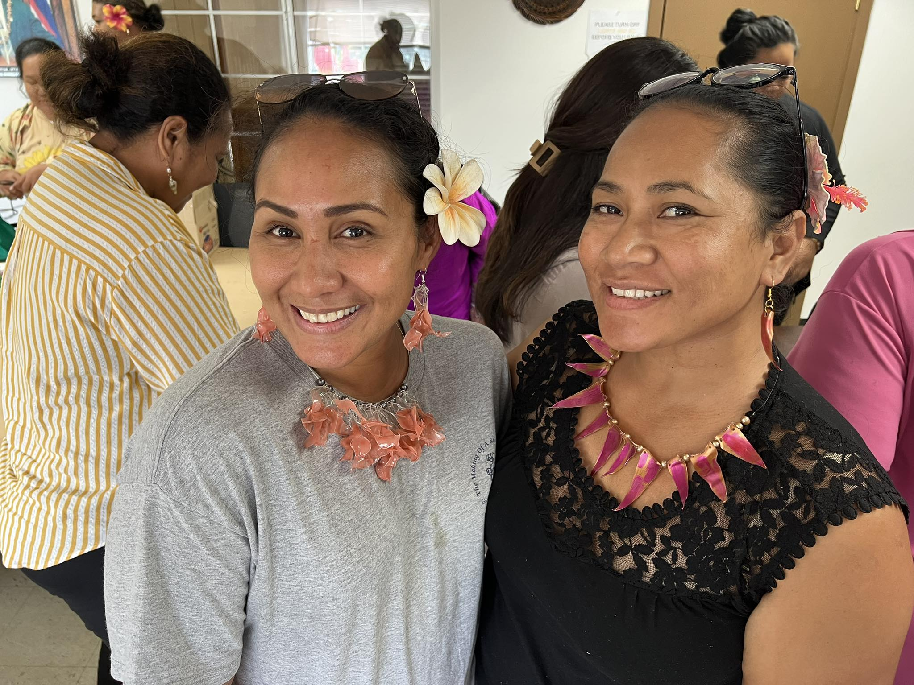
RECYCLE & REPRODUCE Plastic Workshop

Slide 14
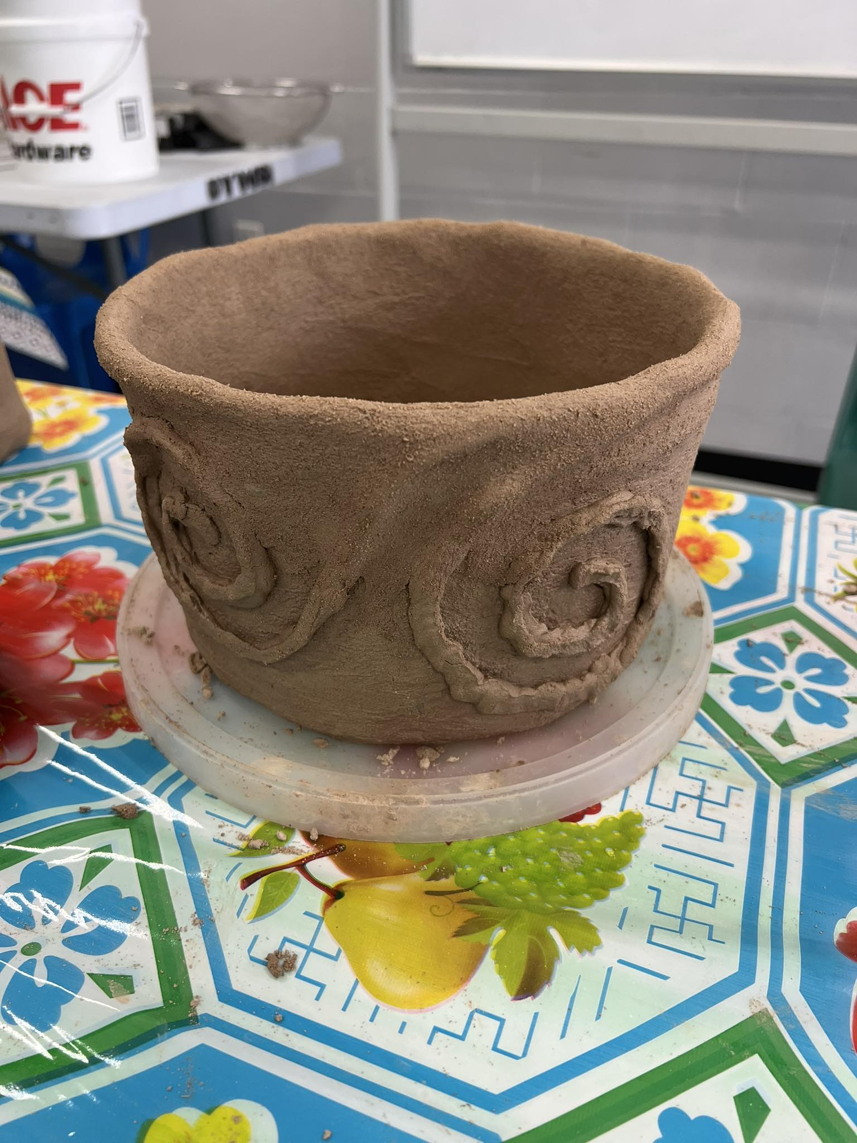

Slide 15
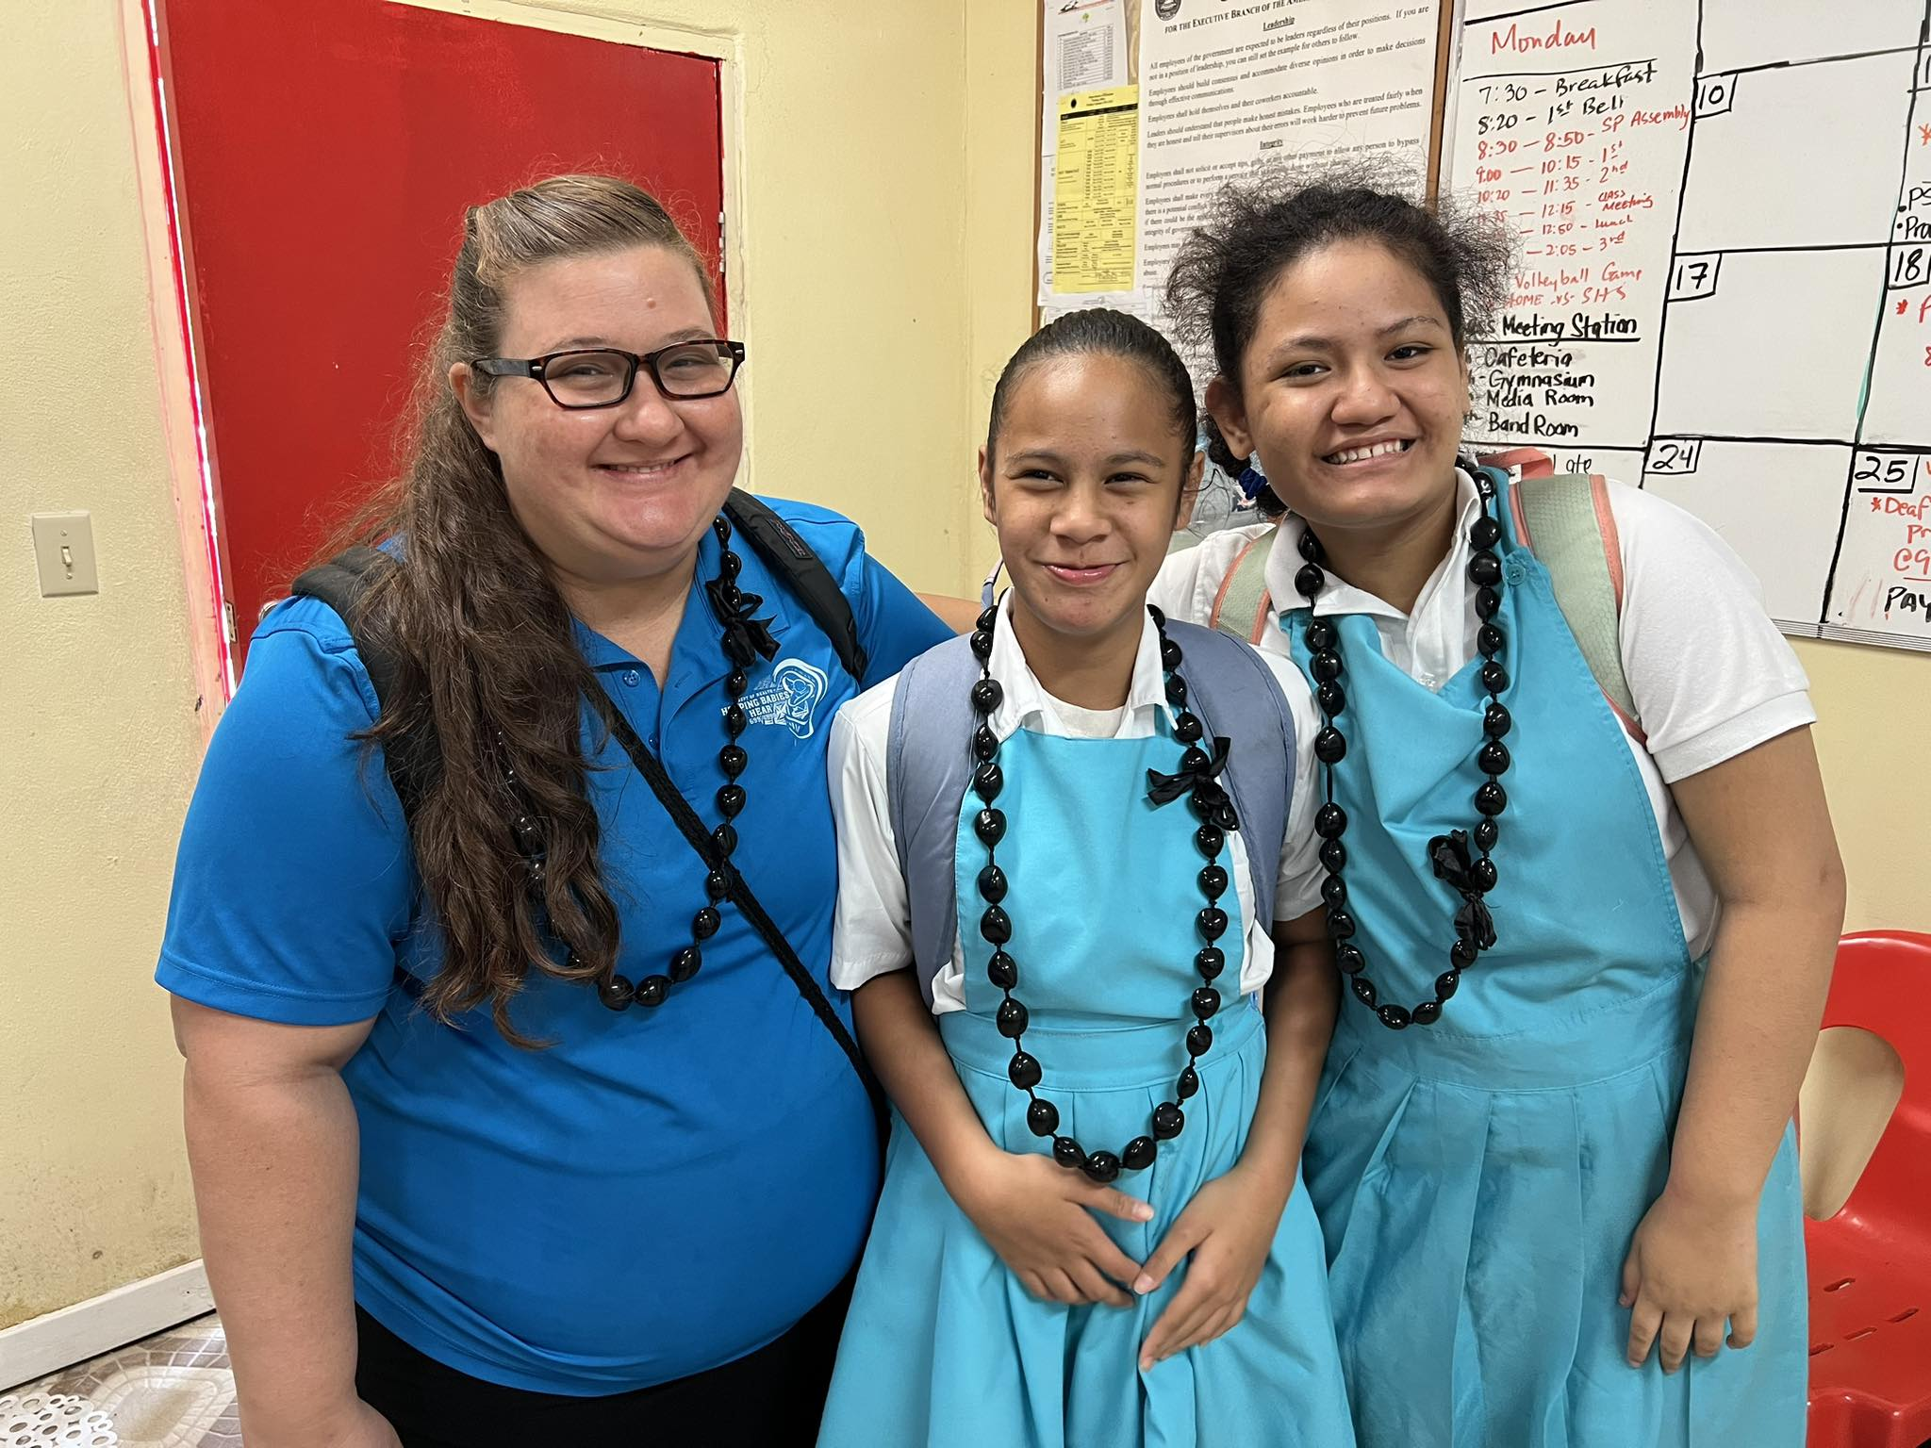

Slide 16
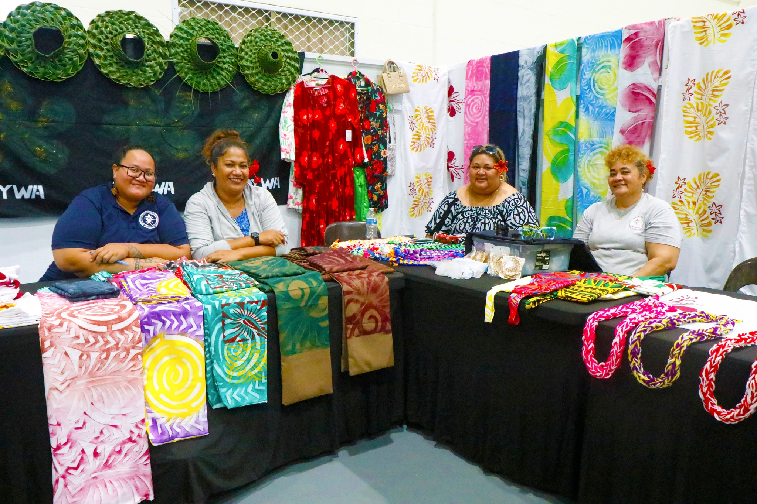

Slide 17
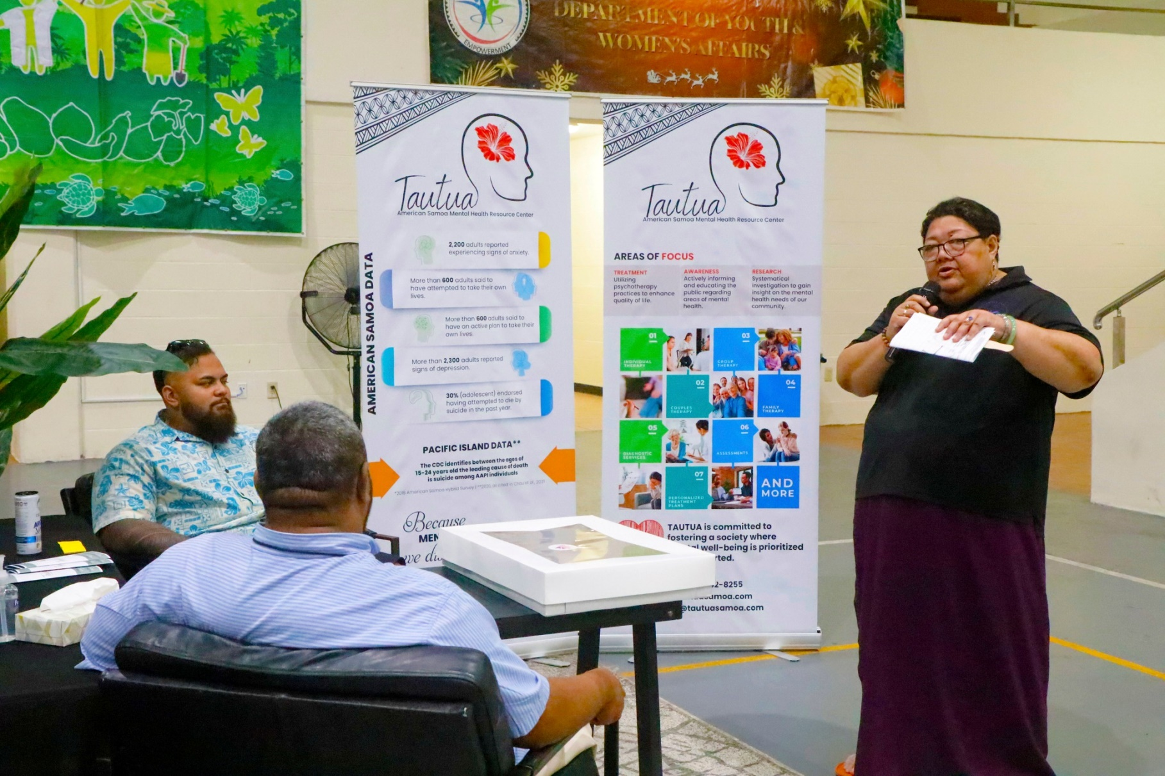
Tautua Samoa: Mental Health Resource Clinic

Slide 18
AS Homeland Security

Slide 19
AS Visitors Bureau

Slide 20
Territorial Administration on Adult

Slide 21
We cannot stop natural disasters but we can arm ourselves with knowledge; so many lives wouldn’t be lost if there was enough disaster preparedness.
-Petra Nemcova

Slide 22
Resilience is all about being able to overcome the unexpected.
Sustainability is about survival.
The goal of resilience is to thrive!

