Slide 1
CLIMATE CHANGE
DISASTER MANAGEMENT TRAINING
Governor Resilience Office

Slide 2
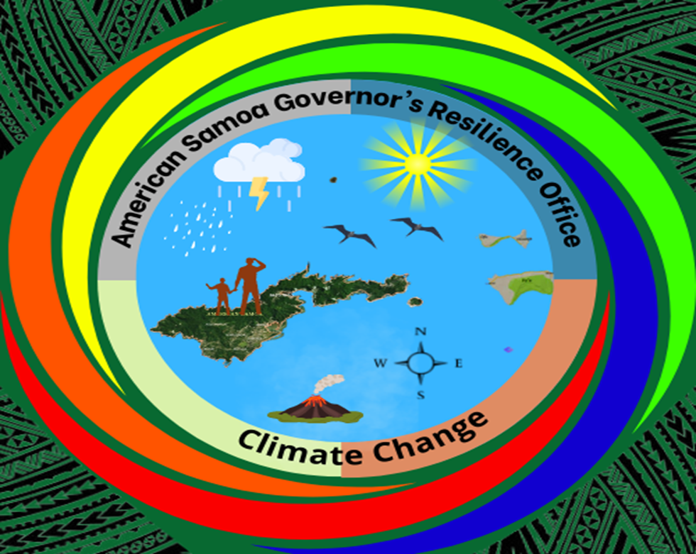
ANTICIPATIVE
FORESIGHT - ENVISION
At peace like a dove, and be wise as a serpent
READING SIGNS OF THE TIME
Scientific findings and cultural / indigenous wisdom

Slide 3
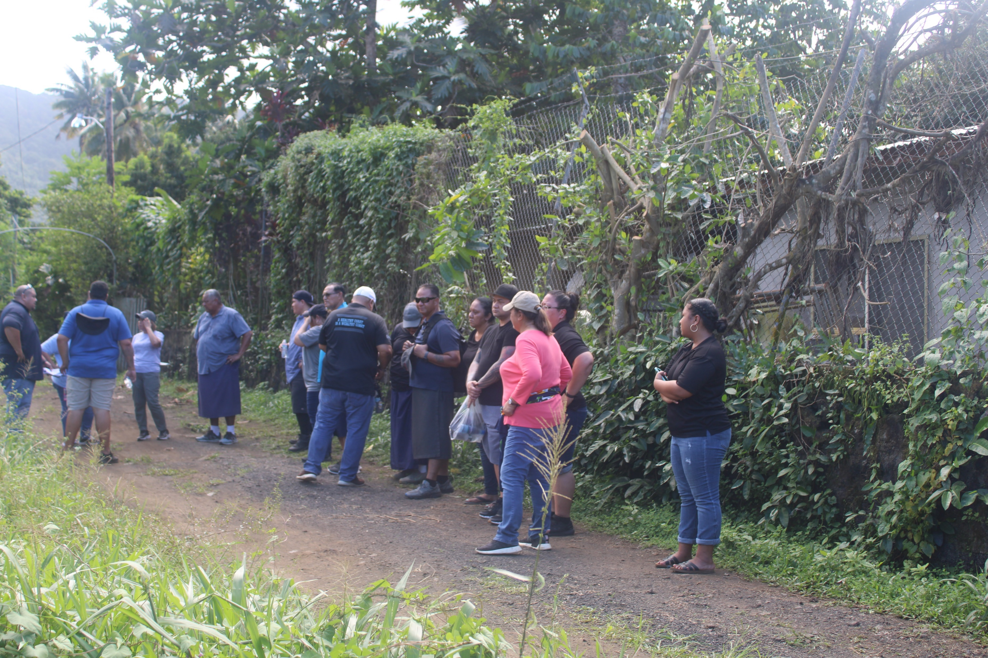
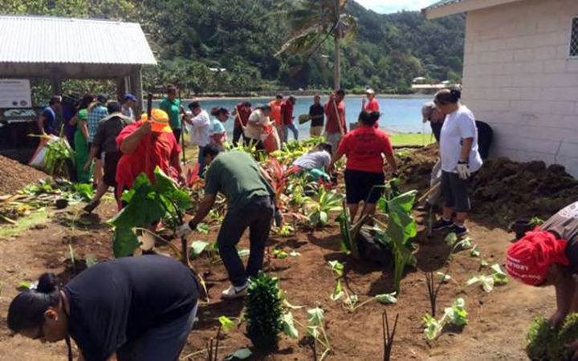
PLAN AHEAD
PROACTIVE
BE PREPARED FOR THE EFFECTS OF CLIMATE CHANGE
INSPIRE CHANGE
INITIATE AWARENESS

Slide 4
ACTIVE
Climate Adaptation and Mitigation
Actions for Climate Resilience and Sustainability - for every disaster
Outreach Programs and Projects to: Schools, Villages, Churches, and Communities
Nature-based Solutions – Green and Gray Projects [Food security, renewable energy, biodiversity and security, infrastructure, etc…

Slide 5
PREVENTIVE
Save oneself and Save the earth
2. Take Precautious Measures
3. Prevention is better than cure

Slide 6
RECOVERY
Addressing root causes of climate crisis
Impactful engagement in climate crisis prevention programs and projects
Utilizing the best available science and technology
Reducing global emissions – not crossing the threshold of 1.5*C

Slide 7
RESTORATIVE
Dealing with climate crisis as an intersecting one – web of life
Efficient and transformative life-systems
Build resilience on a territorial / national scale – address all climate issues transcending boundaries –
Respect of unique cultural values and diversity in building a sustainable territory now and for the coming generations.

