Slide 1
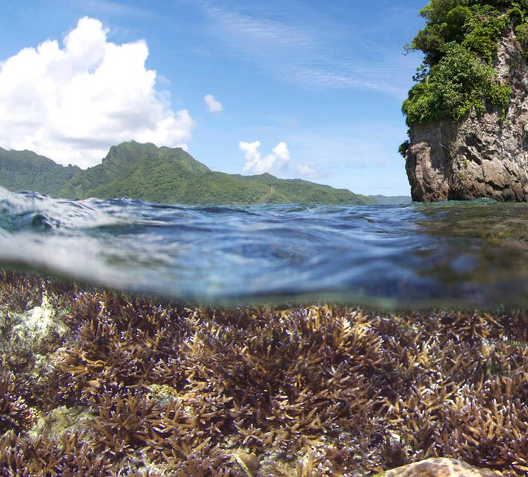
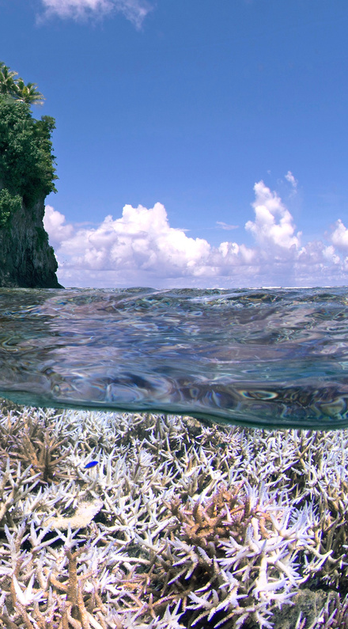
Coral Reef Bleaching
December 2014 February 2015
A SESE UTA, IA TONU TAI
LOCAL GOVERNMENT MANAGEMENT FOR CLIMATE ADAPTIVE PRACTICES
A presentation by:
Casuallen I. Atuatasi

Slide 2
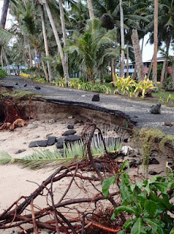
OVERVIEW
Introduction
Problem/Purpose/Research Question
Theoretical Framework
Literature Review
Findings
Recommendations - Policy Actions Today
Future Research
Tsunami 2009, Fagatogo Village
Sea Level Rise, Nu’uuli Village

Slide 3
INTRODUCTION
Climate Change and American Samoa
Environment
Public Health
Economy
Aunu’u, 2021

Slide 4
PROBLEM
No Adaptive Capacity = No Resiliency
CLIMATE CHANGE IMPACTS
NO ADAPTIVE CAPACITY
NOT RESILIENT

Slide 5
PURPOSE
Investigate the current regulatory framework
Uncover keys to solve social issues

Slide 6
RESEARCH QUESTION
What major aspects of the current regulatory framework impact the policy actions of local policy leaders on climate change issues?

Slide 7
GOVERNANCE SYSTEM
INSTITUTIONS
ACTORS
Governance Elements
Power/Knowledge
Institutions/Actors
Configurations structures recommendations
GOVERNANCE
POWER
KNOWLEDGE

Slide 8
LITERATURE REVIEW
Samoan Indigenous Culture, Religion, Economy and Politics have evolved
Indigenous ways impact natural resource management
Influence of external forces on indigenous culture, religion economy and politics

Slide 9
FINDINGS

Slide 10
FINDINGS

Slide 11
APPLYING FRAMEWORK TO FINDINGS

Slide 12
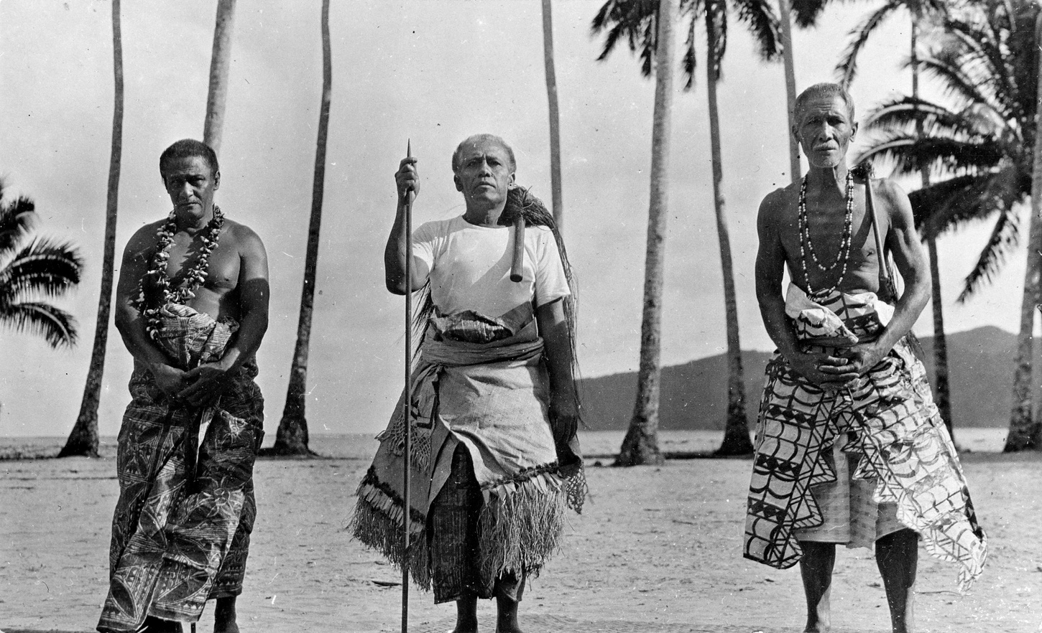
RECOMMENDATIONS
Climate Change Education
Governance Education
Piecing Fragmented Policy Actions
TODAY
Governor’s Resilience Office
Inclusive decision-making process
Increased policy action and attention on climate change issues

Slide 13
A SALA UTA, IA TONU TAI
AS THE SEA LEVELS RISE, SO WILL WE!

Slide 14
Questions?
Matafao Elementary, 2022

