Slide 1
US Department of the Interior
Improving Disaster Resilience in Amerikan Samoa
2nd Annual Amerika Samoa Disaster Resilience Summit
Presented by
The Office of Policy Analysis
Date:
1/27/2022
Presented by
Vanitha Sivarajan
The Office of Insular Affairs
Date:
9/26/2023

Slide 2
Office of Insular Affairs, Department of the Interior

Slide 4
BIPARTISAN INFRASTRUCTURE LAW AND INFLATION REDUCTION ACT (BIL AND IRA)
Bipartisan Infrastructure Law
Restoration of ecological health
Resilient Recreation
Invasive Species
Revegetation of land previously mined for sand, gravel, or coral
National revegetation strategy with native seeds
America the Beautiful Challenge--ecosystem restoration projects
Inflation Reduction Act--support climate planning, resilience, mitigation, and adaptation in the Territories

Slide 5
BIL AND IRA PROJECTS THAT INCREASE DISASTER RESILENCE
USFWS--Rose Atoll National Wildlife Refuge Coral Reef Restoration
ASG Biodiversity Conservation Office--Leone Wetland Ecosystem Restoration
ASG ODAPM--Updating Sea Level Rise Data for all Seven American Samoa Islands
ASG GRO--Sand and Coral Mining, Revegetation of Native Trees/Plants

Slide 6
OFFICE OF INSULAR AFFAIRS GRANT PROGRAMS
Coral Reef and Natural Resources Initiative
Technical Assistance Program

Slide 7
CORAL REEF AND INVASIVE SPECIES PROJECTS THAT INCREASE DISASTER RESILENCE
Southeastern University Coral Fellows Program
USGS--Modeling to Identify where Coral Reef Restoration is Most Effective for Coastal Flood Mitigation
DMWR--American Samoa Marine Invasive Species Detection Program
Ridge to Reefs--Decreasing Land Based Sources of Pollution to Coral Reefs in American Samoa

Slide 8
Territorial Climate and Infrastructure Workshop
March 2022 and May 2023
Goal:
Connect Territorial Climate and Infrastructure Needs with Agency Resources and Technical Assistance, focusing on BIL and IRA

Slide 9
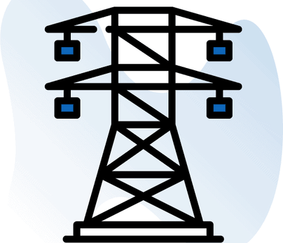
Territorial Climate and Infrastructure Workshop
May 8-12, 2023
Water
Built Infrastructure
Nature-Based Solutions
Invasive Species
Broadband
Energy
Cleanup, Revitalization, & Recycling

Slide 10
REGIONAL BIOSECURITY TRAINING FOR US TERRITORIES, FREELY ASSOCIATED STATES, AND KIRIBATI

Slide 11
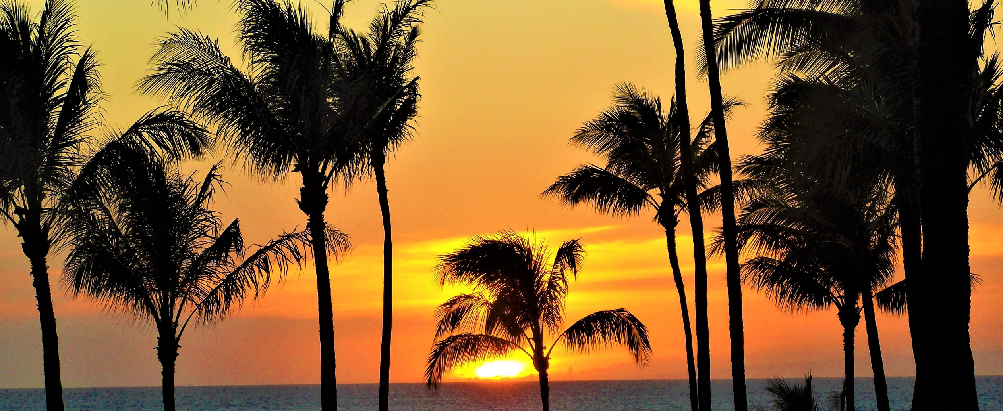
Faafetai! Thank You!
Vanitha Sivarajan
Climate Coordinator
Office of Insular Affairs
Department of the Interior
vanitha_sivarajan@ios.doi.gov

